Slide 1




overall_1_132573879104528179 columns_1_132573879104528179
Microsoft Office Add-ins
Community call
Create a spreadsheet from your website
Upcoming Preview Word APIs
Add-in Support for new Outlook
February 8, 2023

Slide 2

Agenda
David Chesnut
Yun Wang
Nikita Mittal
Juan Balmori Labra
Senior Technical Writer
Principal Product Manager
Senior Product Manager
Principal Product Manager

Slide 3
Create a spreadsheet from your website
David Chesnut: Senior Technical Writer

Slide 4
Useful Links
Open Excel from your web page and embed your Office Add-in - Office Add-ins | Microsoft Learn
Sample code
Based on Microsoft identity sample here
Code sample survey

Slide 5

Upcoming Preview Word APIs – March 2023
Yun Wang: Principal Product Manager

Slide 6

New Word APIs will be in Preview in March
New insertFileFromBase64 API
Style API
Save / Close API
Fields API
Content Control Events API

Slide 7
New insertFileFromBase64 API

Slide 8
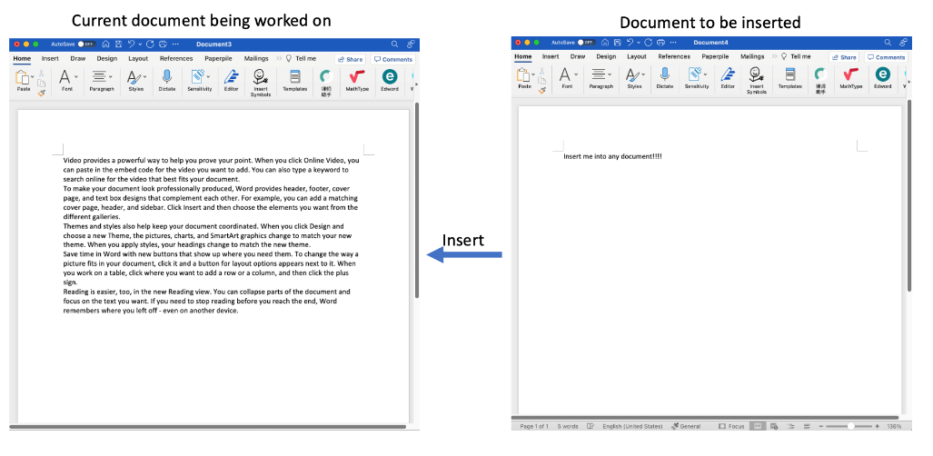
Current Body.insertFileFromBase64 behavior 1
- Existing Body.insertFileFromBase64 is used to insert content of a document into the one that user is currently working on. Only body level content will be correctly inserted.

Slide 9
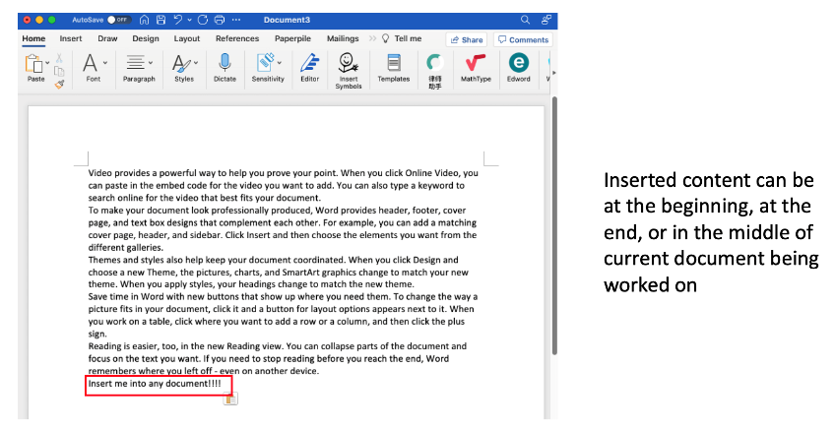
Current Body.insertFileFromBase64 behavior 1

Slide 10
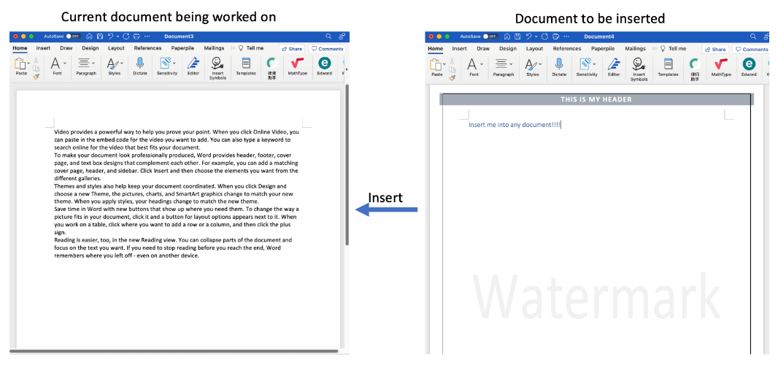
Current Body.insertFileFromBase64 behavior 2

Slide 11
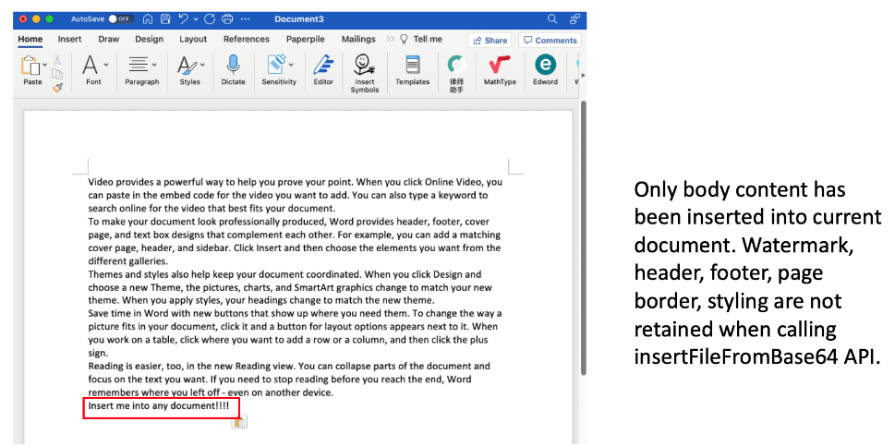
Current Body.insertFileFromBase64 behavior 2

Slide 12
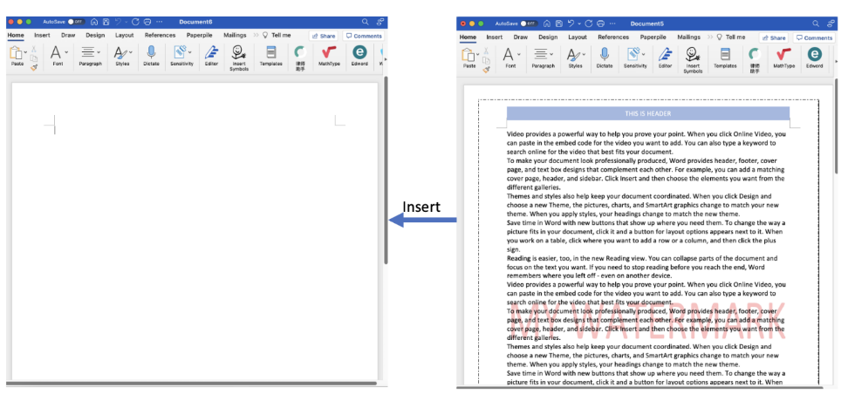
New Document.insertFileFromBase64 API – Case 1
- Inserting file into a blank Word document.

Slide 13
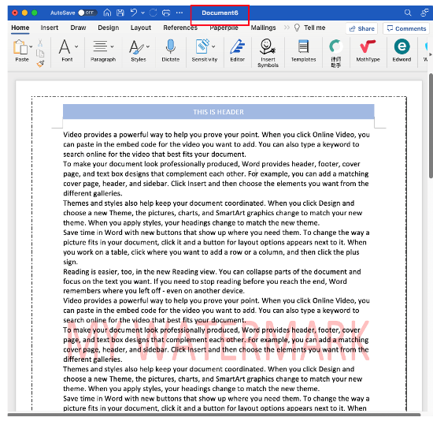
New Document.insertFileFromBase64 API – Case 1
- Inserting file into a blank Word document.
Following settings will be retained after insertion
Page border
Header
Footer
Watermark

Slide 14
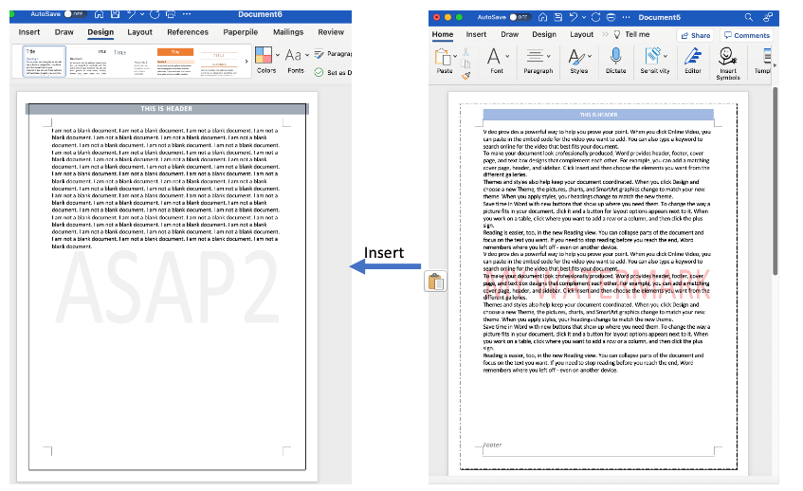
New Document.insertFileFromBase64 API – Case 2
- Inserting file into non-blank Word document.

Slide 15
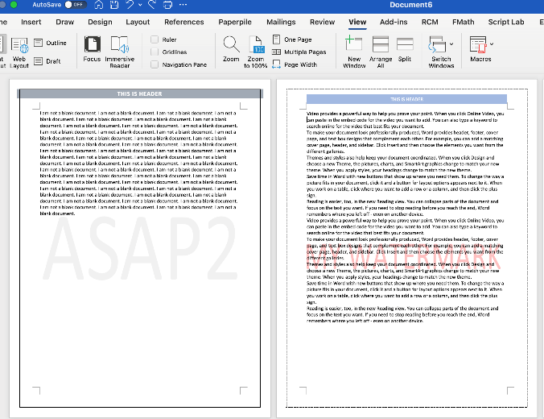
New Document.insertFileFromBase64 API – Case 2
- Inserting file into non-blank Word document.
Following settings will be retained after insertion
Page border
Header
Footer
Watermark

Slide 16
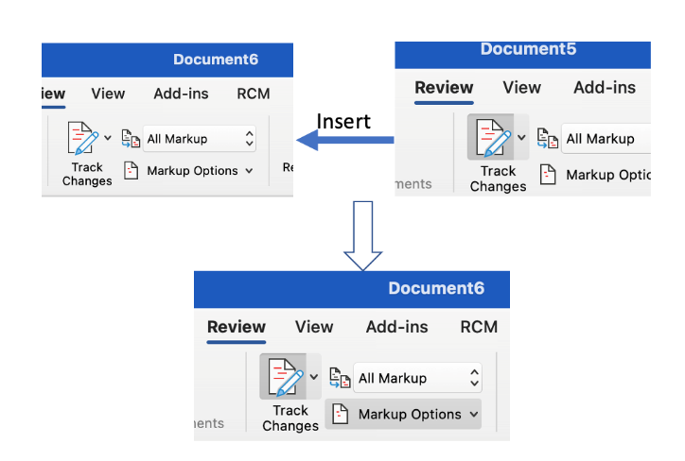
New Document.insertFileFromBase64 API – Case 3
- Developer can control whether to retain track changes settings of the file being inserted

Slide 17
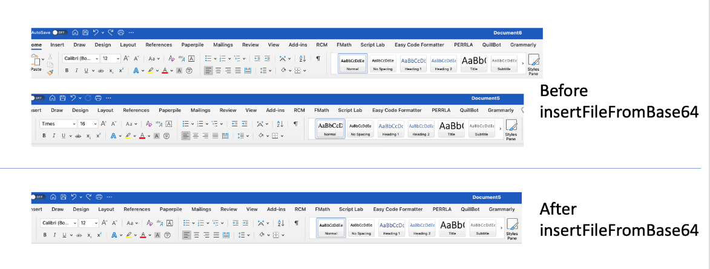
New Document.insertFileFromBase64 API – Case 4
- Developer can control whether to retain style settings of the file being inserted

Slide 18
Style API

Slide 19
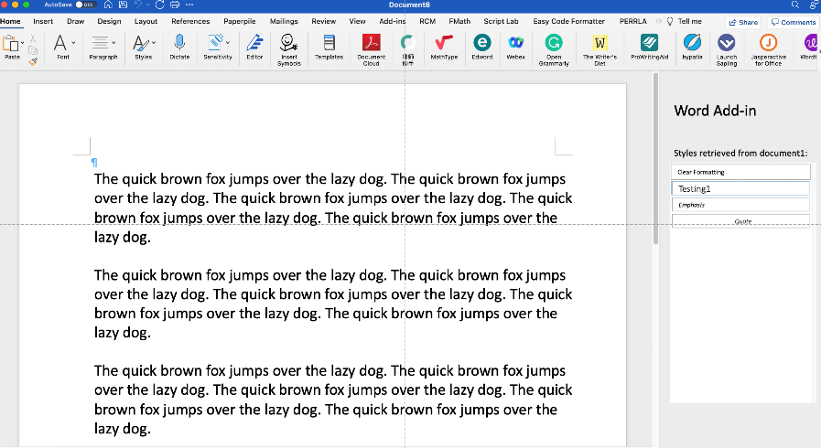
Style API: Add-in Sample
- Add-in retrieves Styles from another document

Slide 20
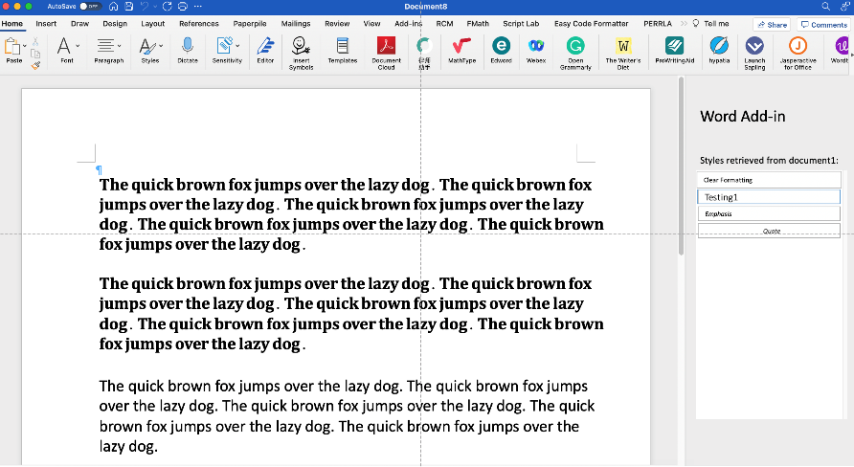
Style API: Add-in Sample
- Add-in select one of the retrieved Styles and apply it to current document.

Slide 21
Style APIs Key Capabilities
Retrieve and parse styles from base64 format of a Word document.
The retrieved styles are added into a collection that could be reused in later process.
The ‘retrieved styles’ includes:
Used styles in the source document.
Customized styles created in the source document.
Insert Styles to a Word document and apply them to specific parts of a document.

Slide 22
Save / Close APIs

Slide 23
Save / Close API
Save API
Save an existing document without prompting dialog
Save a new document with or without prompting dialog
Close API
Changes can be saved or discarded before closing a new or existing document.
After the document has been closed, the add-in will be closed as well. There is no further operation that the add-in can proceed.
No Save/Close event support for now.

Slide 24
Fields API

Slide 25
Fields API
In Word API 1.4, we had already supported Get Fields related functions.
For upcoming preview, the following items will be supported:
Selective Field types. E.g. ADDIN
Create/Update/Delete for the supported Fields types. E.g. Data, Type, etc.
More Fields properties

Slide 26
Content Control Event API

Slide 27
Content Control Event API
Add a Content Control
Data hosted in Content Control has been changed
Delete a Content Control
Selection of a Content Control has been changed
Enter a Content Control ← Newly added
Exit a Content Control ← Newly added

Slide 28
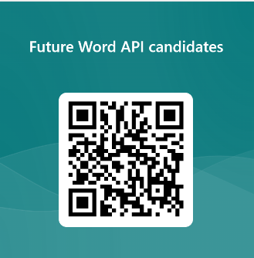
Collecting your feedback - Please let us know your requirements for Word Add-ins by clicking below link or scanning the following QRCode.
https://aka.ms/WordApiNext

Slide 29
Add-in Support for New Outlook
Nikita Mittal: Senior Product Manager Juan Balmori Labra: Principal Product Manager

Slide 30
What is New Outlook?
We are unifying our code base to simplify things for customers and ourselves, and increase engineering velocity
New Outlook is OWA code in a native frame
The new Outlook for Windows is available for Office Insiders
You can find more details here: https://aka.ms/AAjkfje (Getting started with the new Outlook for Windows)

Slide 31
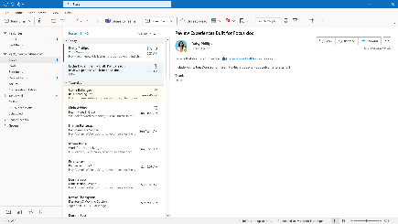
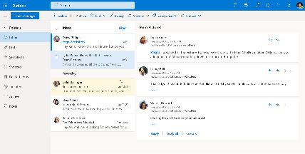
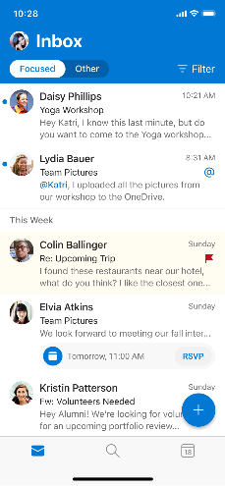
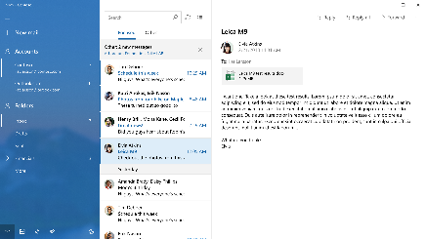
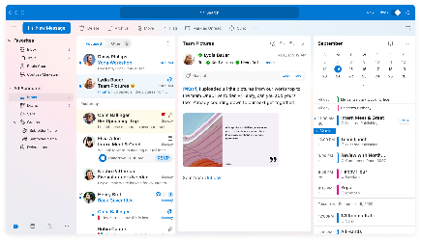
Outlook for Windows
Outlook on the Web
Outlook Mobile
Windows Mail App
Outlook for Mac

Slide 32
Web Add-ins on New Outlook
New Outlook is only available for Windows right now. You can toggle from Windows to move to New Outlook
Web add-ins are fully supported for New Outlook
If you have multiple accounts, web add-ins are currently only available for primary account. We expect full support by fall of 2023
If you face any issues while using web add-ins on New Outlook, please reach out to us on https://github.com/officedev/office-js/issues

Slide 33
What New Outlook means for Developers?
COM/VSTO Add-ins will not be an option in the New Outlook.
Web Add-ins are the future
When
The rollout to try the preview is happening for real production customers this year!
It’s a journey ! (Preview might be as long as the New Mac UI multiyear transition.
NOW IS THE RIGHT TIME TO ENGAGE WITH US
https://aka.ms/DevNewOutlook -> Fill this survey to report any gaps to move your COM add-ins we WANT to talk with you.

Slide 34



Closing the gaps... (for latest status go to: https://aka.ms/OutlookCOM2WebStatus
https://aka.ms/DevNewOutlook
If you don’t see your scenario:
Scenario | Description | Status | Working in Improvements
SPAM reporting and education. | Enable users to report potentially unsafe messages and learn how to identify these messages. | Supported. | SPAM Reporting consolidation More AutoLaunch Events
Online meeting Provider | Enable users to create and join online meetings | Supported. | Support for shared folders.
Meeting boosters | Exposing additional services in the context of creating an appointment such as selecting locations, adding catering services or specific lighting or temperature configurations to a meeting room. | Supported.
Online signatures | Automatically add corporate themed and consistent e-mail signatures into e-mails. | Supported. | More AutoLaunch Events
CRM and tracking scenarios | Provide bidirectional contextual information to and from between a particular e-mail and an external entity (lead in CRM) as well as tracking communications with potential prospects. | Supported.
Content reuse/Reference | Transfer content to and from external sources (text, media, etc) | Supported.
Item Transformation | Transforming mail items into other formats. | Supported
Project management | Creating and tracking issues within external systems. | Supported.
Attachment management | Allow importing or exporting attachments from external locations. | Semi-Supported | Item Multiselect, Context less Add-ins
Message encryption | Encrypt and Decrypt email content. | Semi-Supported | Body Replacement on Read
Data loss prevention | Prevent data loss by detecting and preventing users from sending sensitive information. | Semi-Supported | Sensitivity Label Support
Mail item classification | Identify and classify emails based on sensitive information. | Semi-Supported
Data sync | Bidirrectional synchronization of mailbox items with external systems. | Semi-Supported
Proofing mail items | Real time assistance for composing better, proofed emails. | Not currently supported.

Slide 35
Call to Action for Outlook Mobile Add-in Developers!
We would love to get your feedback about your Outlook add-in and the scenarios you are trying to support. With this information we will know more about how we can best support you.
Please fill out the following survey:
Outlook Mobile Add-in Developer Survey

Slide 36
Question:
We just saw that PowerPoint desktop client now supports PowerPoint API1.5 with the semi-annual channel. We tried the PowerPoint web client and it still does not. Will that be rolling out soon to keep up with desktop client?
Answer:
PowerPoint 1.5 support for PowerPoint Online web app is being rolled out, you should see it being available soon. The functionality should also work even if the supported requirement still returns 1.4 at this time.
Q&A

Slide 37
Question:
I'm writing an add-in that needs to run on Outlook for Mobile and activate at any stage during the composition of a message. Given that the on-send feature and event-based activation do not support Compose Mode on Outlook for mobile, are there any known work-arounds to get an add-in to trigger in Outlook for Mobile when composing a message? Alternatively, is there any update on the roadmap for supporting compose mode for add-ins in Outlook for mobile?
Answer:
This will be answered in the blog post.
Q&A

Slide 38






New to Office Add-ins?
 | Documentation | https://aka.ms/office-add-ins-docs
 | Quick starts | Outlook, Excel, Word, PowerPoint
 | Script Lab | https://aka.ms/getscriptlab
 | Samples | https://aka.ms/officeaddinsamples
 | Microsoft 365 Developer Program | https://aka.ms/M365devprogram
 | Office Scripts | aka.ms/office-scripts-docs
Notes:
m365-dev-sig

Slide 39
Engage with the team
Engagement | Where to go
Technical questions about Office Add-ins | https://aka.ms/office-addins-dev-questions [office-js-dev] [office-addins-dev] https://stackoverflow.com [office-js] [outlook-web-addins] [office-scripts]
Product bugs | https://github.com/OfficeDev/office-js
Feature requests and ideas | https://aka.ms/m365dev-suggestions
Send a Smile or Frown | Inside Office
Notes:
m365-dev-sig

Slide 40
Microsoft 365 developer community calls
Microsoft 365 platform call (weekly) https://aka.ms/m365-dev-call
Microsoft 365 & Power Platform Development (bi-weekly) https://aka.ms/m365-dev-sig
Viva Connections &
SharePoint Framework (bi-weekly) https://aka.ms/spdev-spfx-call
Microsoft identity platform (monthly) https://aka.ms/IDDevCommunityCalendar
Office Add-ins (monthly) https://aka.ms/officeaddinscommunitycall
Power Platform (monthly) https://aka.ms/PowerPlatformMonthlyCall
All calls and assets: https://aka.ms/m365pnp
Notes:
m365-dev-sig

Slide 41
Thank you
Recording will be available in 24 hours on
Microsoft 365 Community (PnP) YouTube channel
https://aka.ms/M365PnP/videos
(subscribe today)
Follow us on Twitter
@Microsoft365Dev | @M365PnP
Next call: March 8th at 8:00 AM Pacific Time
https://aka.ms/officeaddinscommunitycall
Agenda: https://aka.ms/officeaddinsagenda
Submit your questions: https://aka.ms/officeaddinsform

